Slide 1
INNOVATIVE MINI PROJECT
FULL STACK BLOGGING
WEB APPLICATION
BATCH – 4(3-CSE-D)

Slide 2

TEAM MEMBERS
S. SAI SRI VINAY REDDY - 19BQ1A05J7
T. CHANDRIKA - 19BQ1A05M9
S. KAARTHIKEYA - 19BQ1A05L5
Sk. SIDDIK - 19BQ1A05L0
T. SATYA AKHIL - 19BQ1A05P8
Under the supervision of
Dr. G. SANJAY GANDHI, Ph.D.

Slide 3

CONTENTS
Abstract
Introduction
Scenario of Existing Web applications
Problem Statement
Proposed Solution
Operating Environment
Future Enhancements
Screenshots

Slide 5
ABSTRACT
Blogging refers to writing, photography and other media that is self-published in online. It has started an opportunity for individuals to write diary-style entries. It enables you to reach the billions of people that use the internet. Looking into the technical elements, there are some popular blogging websites like Blogger, Tumblr etc. Every application has functional and non-functional requirements. Some non-functional requirements are design, performance, responsiveness and speed of the application. With the help of modern web frameworks, we can improve the UI design with Tailwind which contains reusable components, that makes the development easier and make the application to look attractive and responsive. With modern back-end technologies the process of fetching/ storing data became simple, efficient and reliable, hence the performance and speed is improved. The code redundancy is reduced, which makes the web application simple and light in weight. The special features (functional requirements) of this web application is improved design patterns(like MVC) which enhances the performance, readability of the code and maintenance of the application.

Slide 6

INTRODUCTION
What is a blog?
A blog is a discussion or informational website published on the World Wide Web consisting of informal diary-style text entries (posts).
Posts are typically displayed in reverse chronological order, so that the most recent post appears first, at the top of the web page.
What is the purpose of a blog?
The purpose of a blog is to provide content on your website that answers your prospective customers' questions and helps them learn about your product or service. It expands your brand's visibility by giving Google and other search engines content to index and serve up in search results.

Slide 7

POPULAR BLOGGING WEBSITES
WordPress.com
WordPress.org
Medium.com
Blogger.com by Google.
Tumblr.com
Wix.com

Slide 8
SCENARIO OF EXISTING WEB APPLICATIONS
These are not very serious issues with most of the users, but with improving day to day technological trends, user experience is given more priority over functionality of the application.
Users are giving much importance to the visual experience of the application. They are expecting more about styling.
With the existing applications, these aspects seems to be slightly outdated, so the main focus is done on these aspects.

Slide 9

PROBLEM STATEMENT
To develop a blogging web app that serves the purpose of bloggers/ content creators by giving more priority to non functional requirements of the application such as styling, visual experience, positioning of components and performance improvements with the use of modern web technologies and frameworks.

Slide 10
PROPOSED SOLUTION
A sleek and attractive website is designed to display the posts, filter them by categories, added a dedicated slot to featured posts, recent posts, comments etc..
All the data is maintained securely in the GraphCMS portal and is handled by admins and editors of the blog
The comments posted by users are verified and published by a team of authorised members to prevent unrelated comments and to avoid spamming.
Entire application is maintained as a Single Page Application(SPA), which is easy to maintain, easy to navigate between the sections and faster in performance.

Slide 11

OPERATING ENVIRONMENT
Languages used:
For UI Design:
ReactJS, NextJS, Tailwind CSS
For Backend Operations:
NodeJS, GraphCMS
Running Environment:
Any updated browser like Brave/Chrome
Tools:
VScode, Github
System Requirements:
RAM : 4GB or above
Disk space : 4GB or above
Processor : any updated 64 bit processor
Operating System: Windows/ Mac/ Linux

Slide 12

FUTURE ENHANCEMENTS
Improve the UI further by adding new features such as no. of likes, shares etc..
Adding more catogeries other than professional ones, like productivity tips, developer life stories, corporate life and work styles etc..

Slide 13

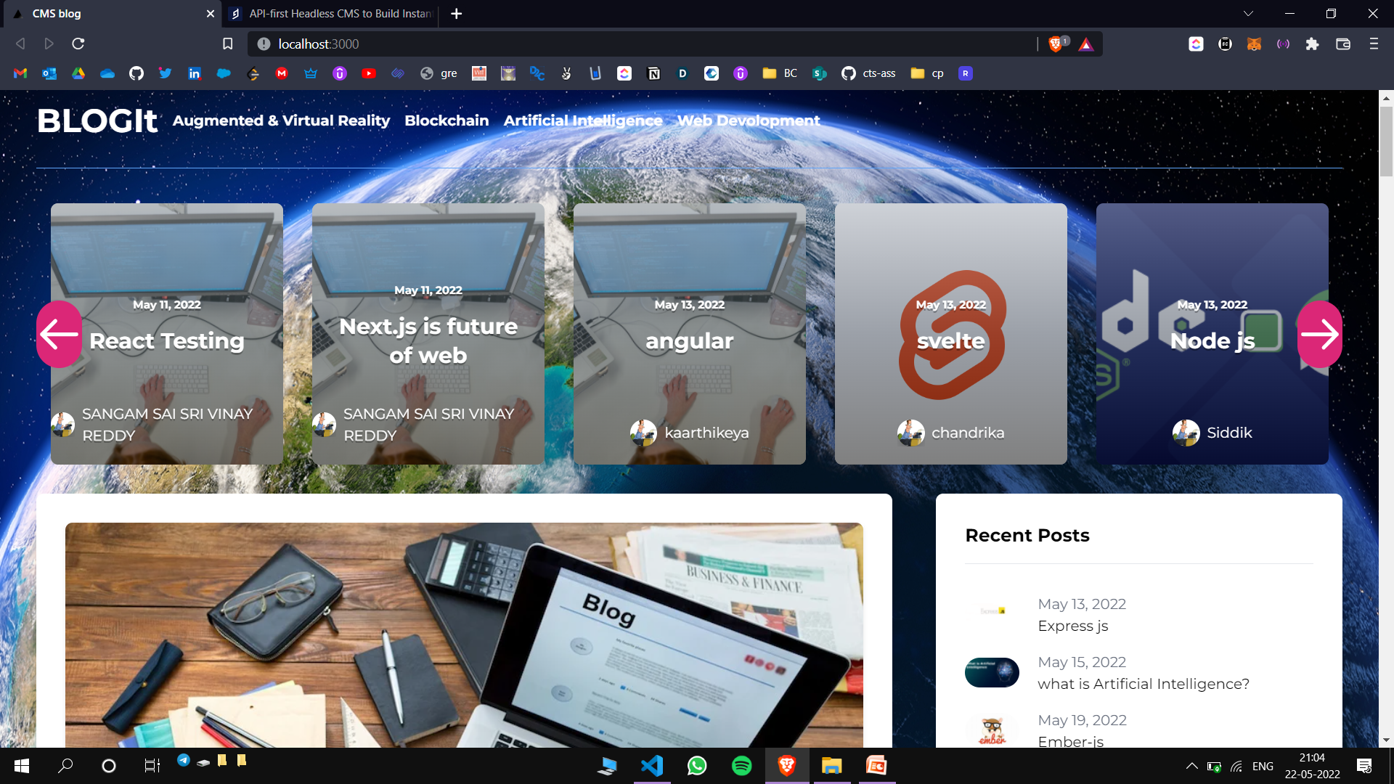
SCREENSHOTS
Home screen of the application

Slide 14
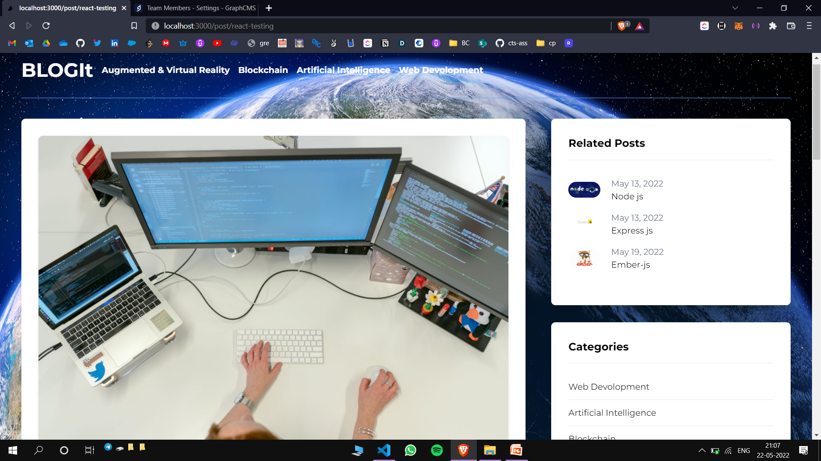
Category post – web development

Slide 15
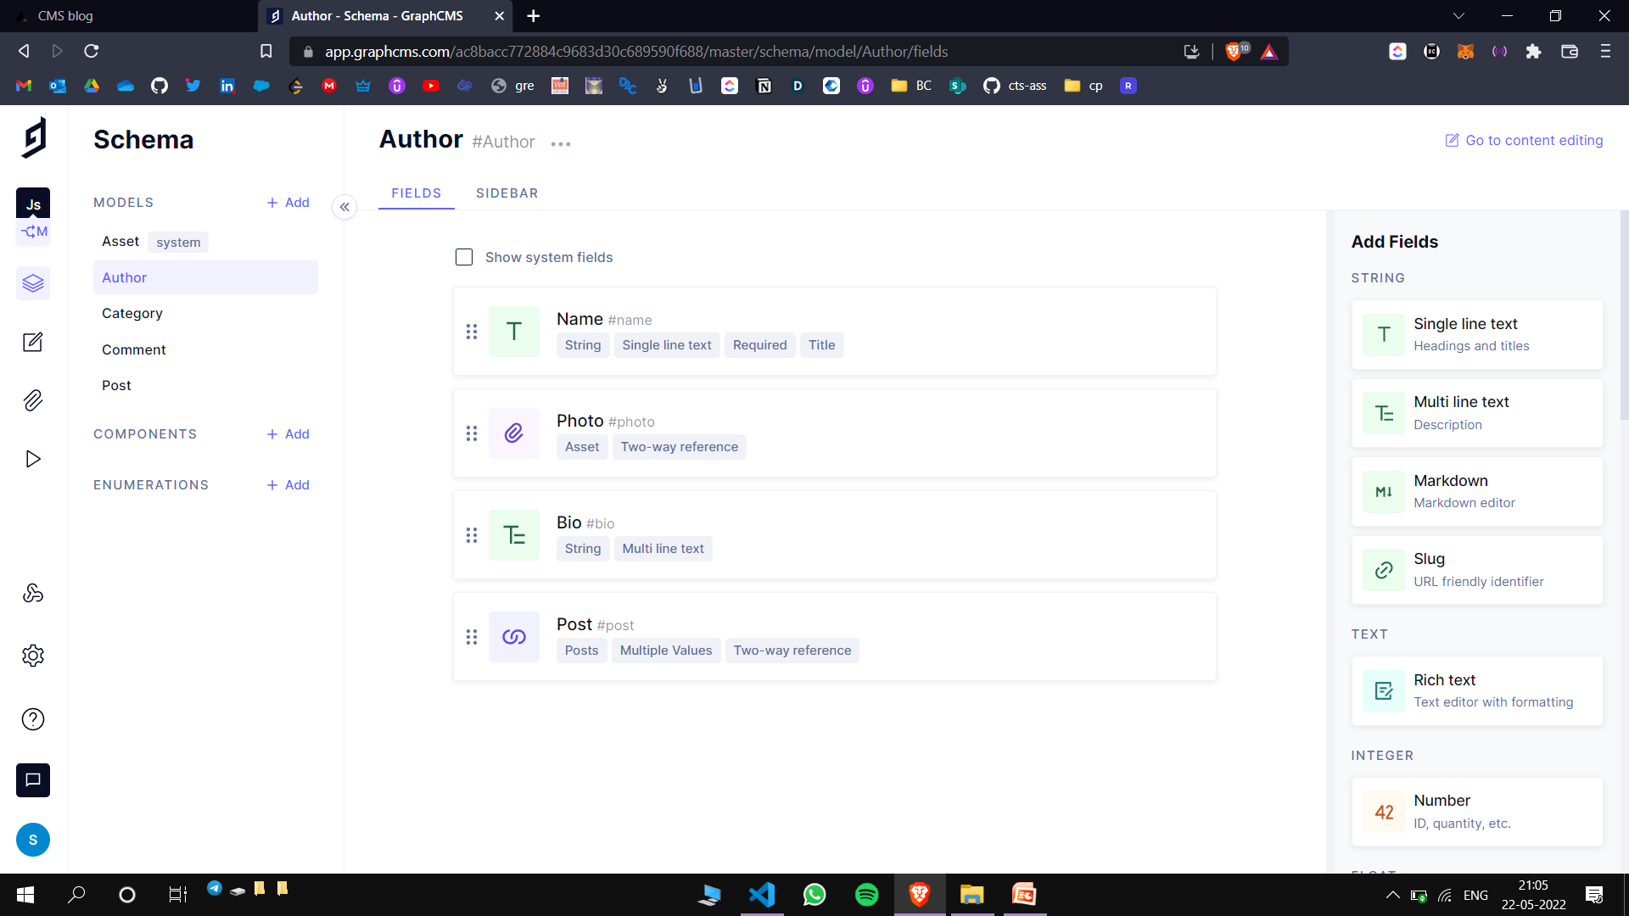
Exploring Graph CMS portal
Defining the schema

Slide 16
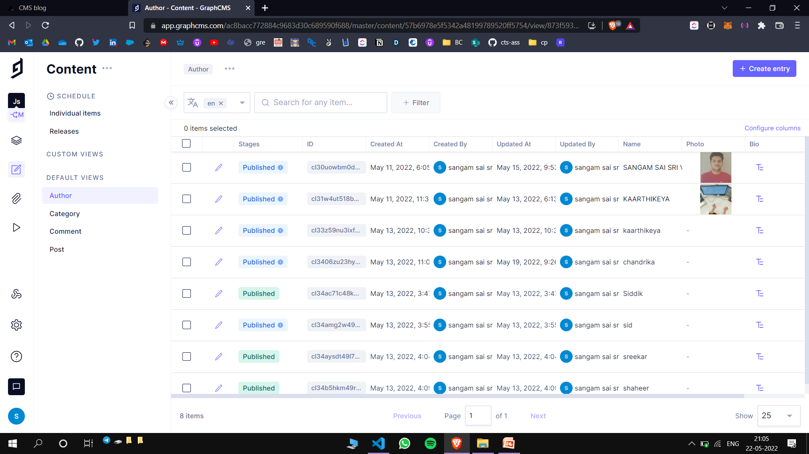
Maintaining the content inside the portal

Slide 17
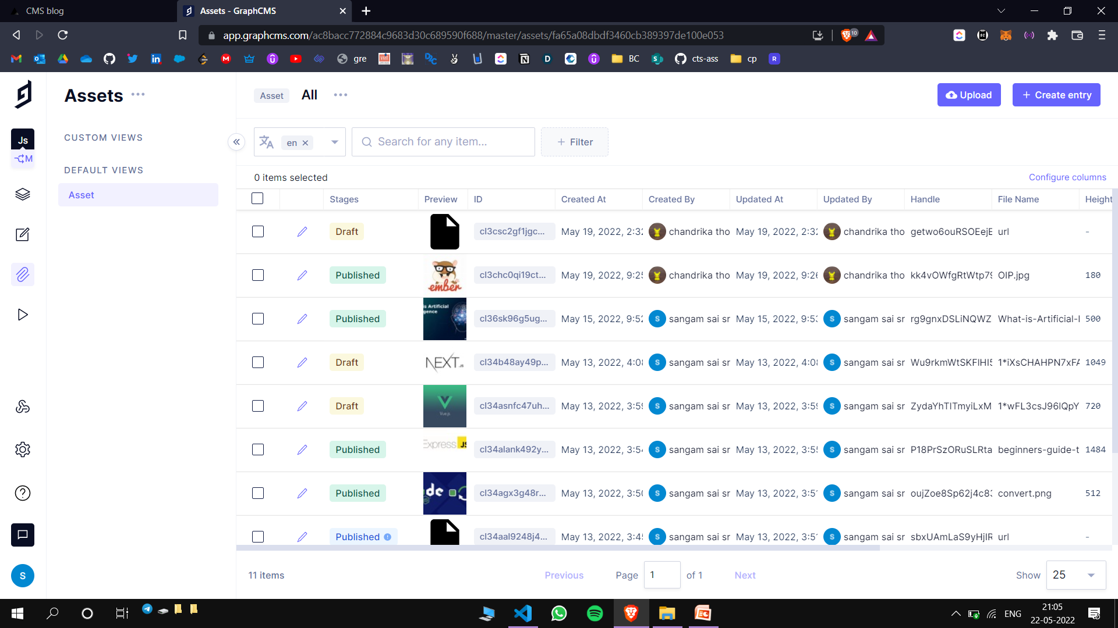
Maintaining the assets like images, links etc.

Slide 18
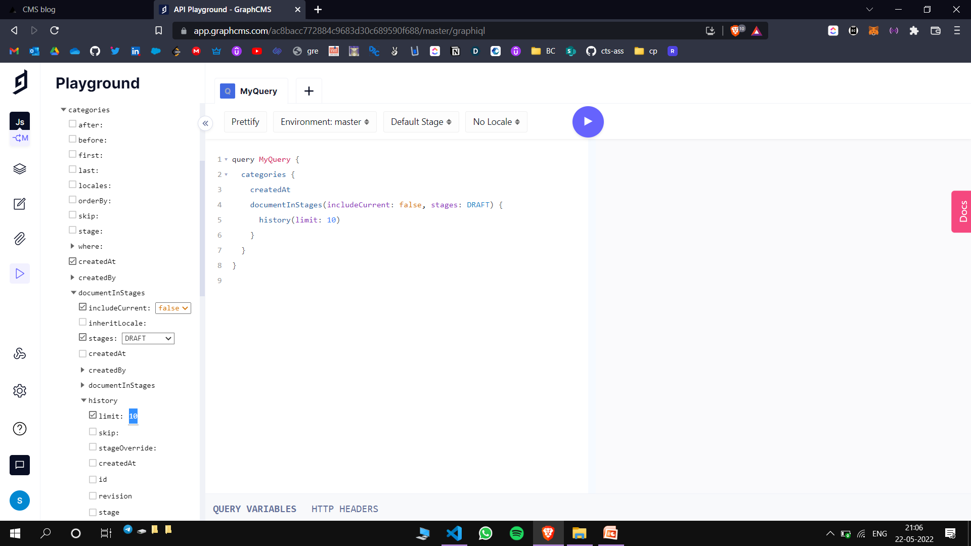
Generating the api calls in GraphQL language

Slide 19
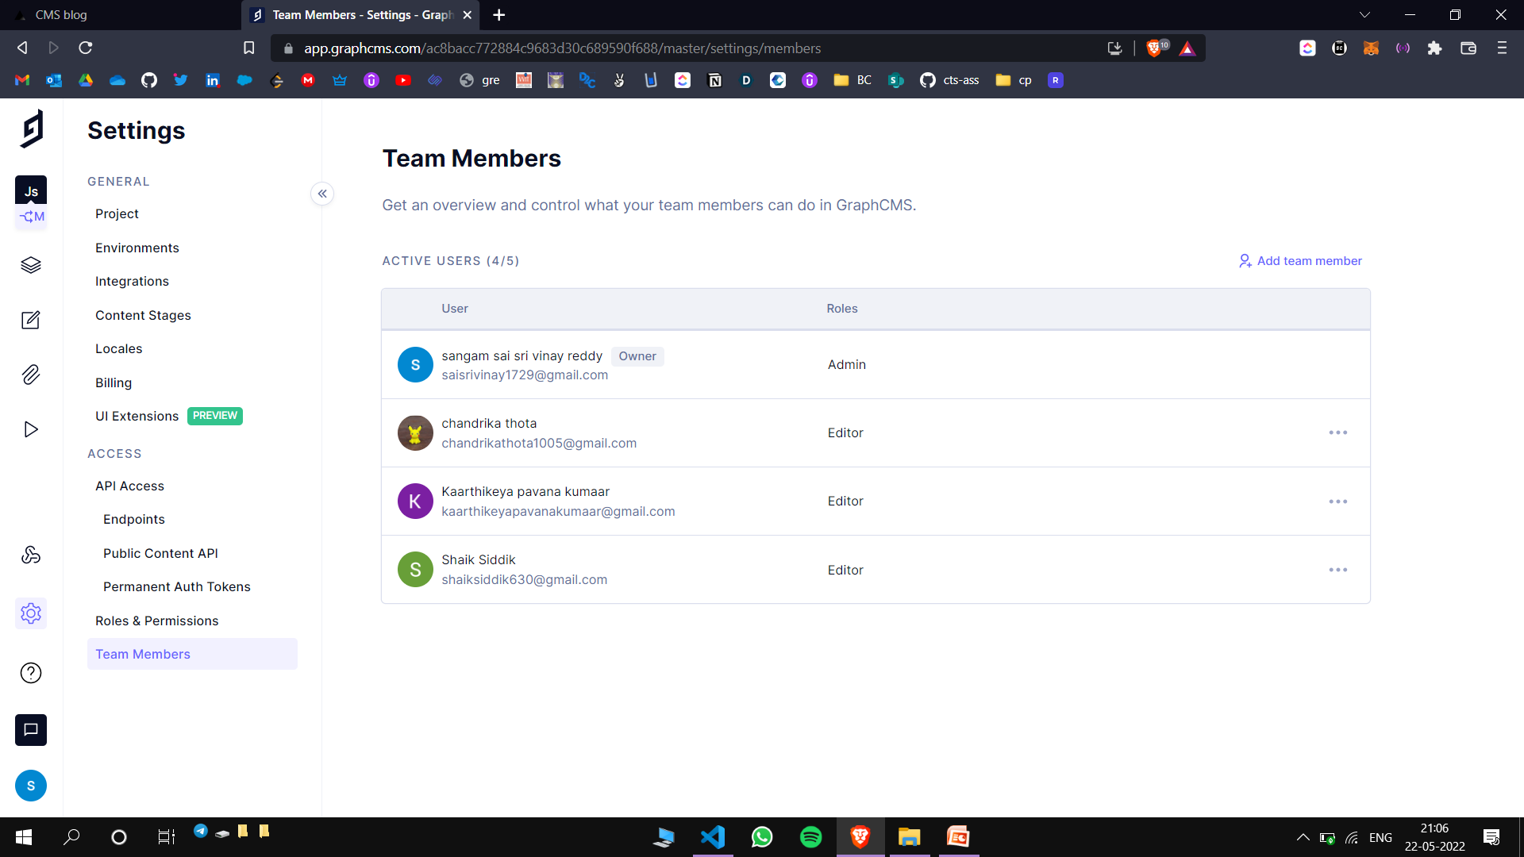
Admin portal

Slide 20


